Slide 1
FASHION
CLOTHING

Slide 2
What is Fashion
Fashion is a general term for a popular style or practice, especially in clothing, footwear, accessories, makeup, body piercing, or furniture.
Areas influenced by fashion – how?
Clothing, hairstyles, music, language, home furnishings, cars, art, education
Fashion x progress

Slide 3
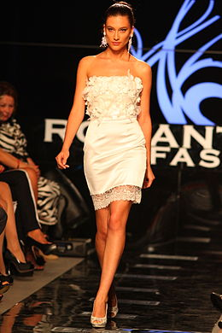
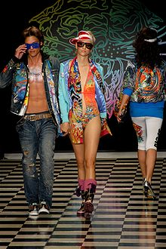
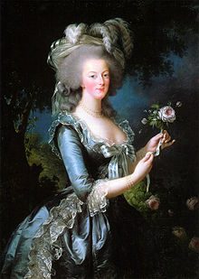
Trends in fashion

Slide 4
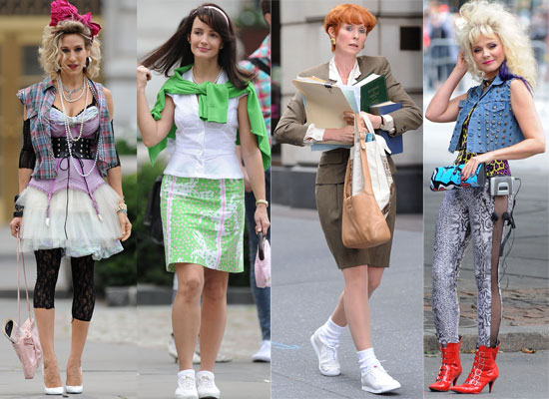
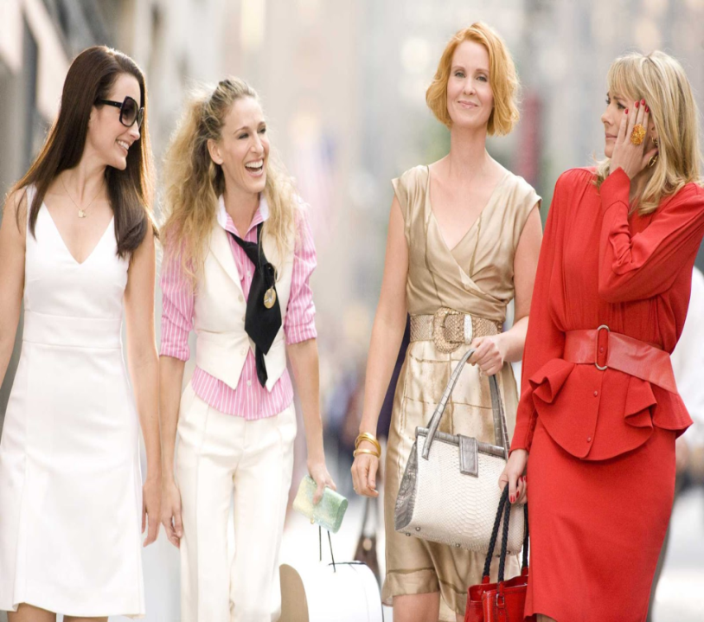
There is something ridiculous about fashion
https://www.youtube.com/watch?v=piX6colJrXc
https://www.youtube.com/watch?v=MSF8DGfmS0g

Slide 5
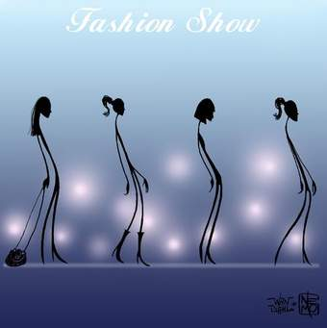
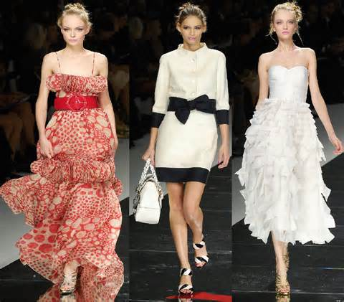
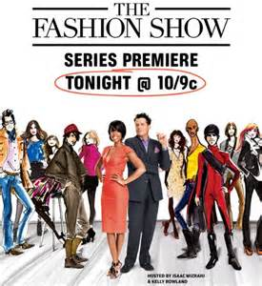
FASHION SHOWS, models

Slide 6
Fashion fail
What is it FASHION FAIL?
Can you name some (Czechs are famous for)?
-Socks with sandals, or disgusting feet with sandals
-Czechs also don’t know how to dress for the occasion, be it job interview, wedding, opera, a date, or dinner. Czech women often try to be sexy and overdo it, too short skirts – plenty of them, too open cleveages everywhere – no matter what age
-For dancing balls – borrowing dress made of kilometers of cheap satin, long-pointed shoes and overdone curly hairstyles
-stop caring for themselves as they get older (loose T-shirts, outdoor jackets)
Check this out…
http://www.dose.com/style/18315/If-You-Think-You-ve-Seen-The-Worst-Fashion-Fails-Feast-Your-Eyes-On-These-16-Atrocities-ab911-0

Slide 7
You and clothing
What clothes do you like to wear?
Do you like shopping for clothes?
In what shops dou you buy your clothes (high street fashion, boutiques, second hand, fashion designers shops, Vietnamese shops, tailored clothes, making them yourselves?
What do you like to wear at home, for the garden work, for school, school trips, concerts, discos, to bed, on your holiday?
Do you feel comfortable with your figure – would you like to change anything?
What are the clothes shopping opportunities in Hlinsko?
Roleplay – with your partner decide what clothes item to buy for you good friend, her taste considering

Slide 8
Vocabulary
PREZENTACE CLOTHES – DESCRIBING PICTURES
Clothes for various events
Materials
Patterns
Designs
Accessories
Parts of clothes
Problems connected with fashion:
Eating disorders, brand bully, uniforms, consumerism – wasting of energy and materials, fashion idols

Slide 9
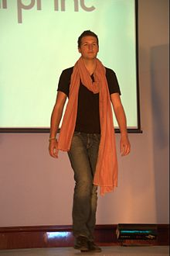
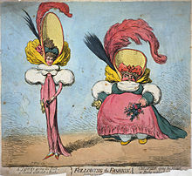
Clothing in different groups
Men and women
Old and young
Country people x city people
Manual workers x office workers

Slide 10
references
http://en.wikipedia.org/wiki/Fashion

